Slide 1
More

Slide 2
Making your life Count!
Eph. 5:1,2 “Be ye therefore followers of God,
as dear children;
And walk in love, as Christ also hath loved us,
and hath given himself for us …
8 For ye were sometimes darkness,
but now are ye light in the Lord:
walk as children of light:…
9 Proving what is acceptable unto the Lord.”

Slide 3
Eph. 5:14 “Wherefore he saith, Awake thou that sleepest, and arise from the dead, and Christ shall give thee light.
15 See then that ye walk circumspectly,
(akribos’: Carefully, diligently)
not as fools, but as wise, (Sophos: clear)
16 Redeeming (exagorazō: ransoming, rescue from loss)
the time, because the days are evil.
(poneros: infected, hurtful {in effect or influence})
17 Wherefore be ye not unwise,
but understanding what the will of the Lord is”

Slide 4
“Understanding what the will of the Lord is.”
Pr 3:5,6; Heb. 11:6; 1 Jn 5:4

Slide 5
Eph 5:15 “See then that ye walk circumspectly”
Webster’s defines “circumspectly” as
“cautiously, considering all of the circumstances.”
Satan seeks to blind or distract us from the eternal aspects and implications of our choices so that we don’t
“consider all of the circumstances”
or all of the consequences of our choices.

Slide 6
He’s a master at Distraction, Deception and Seduction.
(Mt 7:14; John 8:44; 2 Cor 4:4; 11:3)
He seeks to sabotage our faith journey by keeping us “in the dark” (2 Cor 4:4) about the implications of eternal,
critical questions.

Slide 7
If we miss the mark on these critical questions, we can easily drift off course, and end up spiritually shipwrecked. (1 Tim. 1:19)
Mt 7:7 “Enter ye in at the strait gate:
(stenos: narrow from obstacles standing close)
for wide is the gate, and broad is the way,
that leadeth to destruction,
(Apōleia: ruin, loss, waste) see Rev. 9:11
and many there be which go in thereat:”

Slide 8
Existence: Why am I here?
You were created to:
Have a Consummate (intimate, perfect)
relationship with God. (Jer 31:3; 1 Jn 4:7-10)
Cooperate (partner) with Him and His plans.
(Mt 11:29; 2 Cor 3:9; Eph 2:8-10)
Conquer Satan’s attempts to seduce, sidetrack, and sabotage you. (Ro. 8:35-39; 1 Jn 4:4; 5:4)

Slide 9
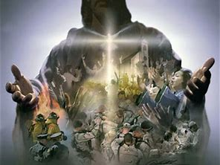
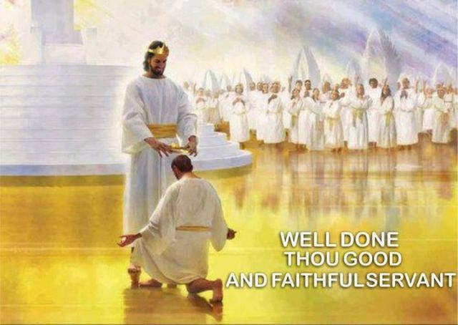
Significance: Do I matter?
You weren’t created for just survival,
Or even temporary success;
but for eternal Significance!
Jn 10:10;
Ro. 8:37;
Eph. 1-2:10
1 Tim. 4:8

Slide 10
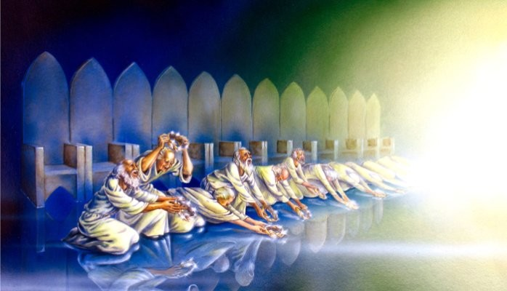
Intention: The Point (Purpose) of life!
“Thou art worthy, O Lord, to receive glory and honor and power:
for thou hast created all things,
and for thy pleasure (thelēma: Purpose, desire)
they are and were created.”
Mt 11:29; 1 Cor 3:9; 4:1;
2 Cor 5:20
Revelation 4:11

Slide 11
Since we didn’t create ourselves, we can’t find these answers (our meaning) isolated from God.
Eccl. 3:11 “He hath made every thing …
also he hath set the world (ôlām: eternity) in their heart,
so that no man can find out the work that God maketh from the beginning to the end.” (Rev 4:11)
Attempting to do this leads to the “vanity” (33x) that Solomon wrote of when we seek to understand life “under the sun.” (28x in Eccl.)

Slide 12
Answering these questions about our Existence, Significance, and God’s Intention
inevitably lead to another significant question;
That of Expectation.
What does God want from me?
Thankfully God is not coy about this answer!

Slide 13
What Does God Want From us?
Our Heart!
Pr 23:26 “My son, give me thine heart,
(lēḇ: mind, will, emotions;
and let thine eyes observe (nāṣar: guard, preserve)
my ways.” (dereḵ: path or course of life)
{aka “The center”})

Slide 14
Dt 10:12,13 “what doth the LORD thy God require of thee, but to fear the LORD thy God,
to walk in all his ways,
and to serve the LORD thy God with all thy heart and with all thy soul,
To keep the commandments of the LORD,
and his statutes, which I command thee this day
for thy good?”
and to love him,

Slide 15
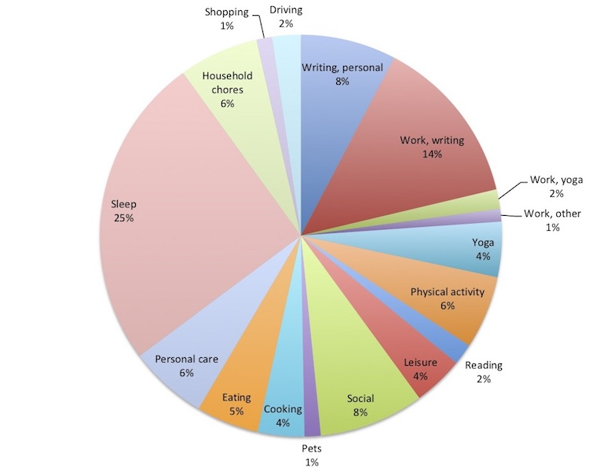
We tend to shape and separate our lives into slices (sections, priorities).
A. Reactive living allows others to cut the slices.
We adapt to the demands
& expectations of others
to make room in our lives
for their agendas/priorities.
2) To some degree this is
inevitable and necessary.
(1 Cor 7:32-34; Gal. 5:13; Phil. 2:2,3)

Slide 16
We tend to shape and separate our lives into slices (sections, priorities).
A. Reactive living allows others to cut the slices.
3) Without clear priorities (to direct us) and boundaries (to protect us) reactive living usually leads to getting trapped in the “tyranny of the urgent”,
(where everyone else’s crisis becomes our priority).
This eventually leads to Frustration, Exhaustion, and Indignation.

Slide 17
B. Proactive (purposeful) living enables us to determine (or influence) the shape/sizes of each slice.
1) Some problems with this include our limited:
➔ Time/ energy/ experience / understanding
➔ Control / Ability (Much of life is beyond control)
➔ Our selfish natures. Jer. 17:9
2) Some benefits include being able to prioritize
(aka: redeem) your “discretionary” resources.
(Time, Money, energy, etc) Eph 5:16

Slide 18
A. Reactive living: Others pick the slices of our lives.
B. Proactive living: We allocate the portions/priorities.
C. Spiritual living Enables Christ to be the center of our
souls (lives), directing us through his Spirit and Word.
John 15:1-4 4“Abide in me, and I in you. As the branch cannot bear fruit of itself, except it abide in the vine; no more can ye, except ye abide in me.”
The Bible describes this as:
“walking in the Spirit” (Ro 8:1→; Gal. 5:16-26)
“Living or Walking by Faith” (Ro 1:17; Heb 10:38)
or simply “acknowledging him” (Pr 3:6)

Slide 19
2) Spiritual living transforms us.
(Ro. 12:2; 2 Cor 3:18; Gal. 2:2)
2 Peter 1:2-4 “Grace and peace be multiplied unto you through the knowledge of God, and of Jesus our Lord,
3 According his divine power hath given unto us all things that pertain unto life and godliness, through the knowledge of him that called us to glory and virtue:
4 Whereby are given unto us exceeding great and precious promises:
that by these ye might be partakers of the divine nature,
having escaped the corruption that is in the world...”

Slide 20
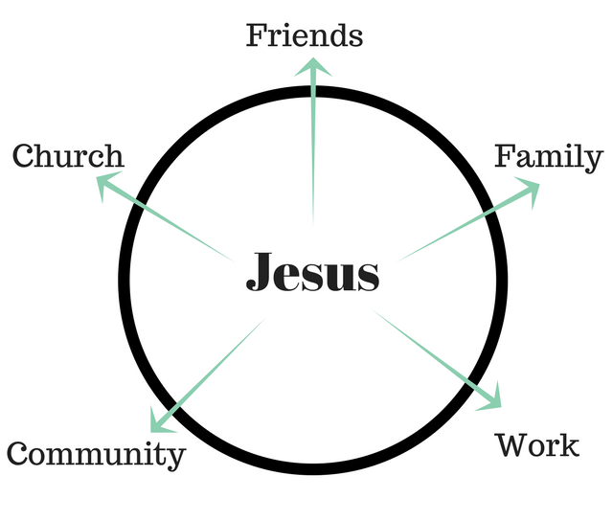
2. God doesn’t want a “slice of you”,
He wants the very Center!
Pr 23:26
“My son, give me thine heart…”

Slide 21
God doesn’t want to be “a part” of your life;
He wants to be “pre-eminent”!
(Col. 1:17,18) “He is before all things,
and by him all things consist, (synis’tēmi: stay together)
And he is the head of the body, the church:
who is the beginning, the firstborn from the dead;
that in all things he might have the preeminence.”
(Prōteuō: first in rank, order, influence)
Aka: at the Center!

Slide 22
2. God doesn’t want to be “a part” of your life;
He wants to be “pre-eminent”!
A. Jesus repeatedly made this clear.
Mt. 22:37,38 “Thou shalt love the Lord thy God with
all thy heart, with all thy soul, with all thy mind.
This is the first (protos: foremost) and great (megas: large, loud, mighty) commandment.”
(Entole’: injunction, authoritative prescription!)

Slide 23
God wants to be “pre-eminent”! (Col. 1:17,18
A. Jesus made this clear.
1) You can’t have multiple masters. Mt. 6:24
“No man can serve two masters:
for either he will hate the one, and love the other,
or he will hold to (antech’ōmai: support) the one, and despise the other.
Ye cannot serve (douleuō: be in bondage to)
God and mammon.”

Slide 24
God wants to be “pre-eminent”! (Col. 1:17,18
B. God isn’t vague about this! Ro 12:1,2
“present your bodies a living sacrifice…which is your reasonable service.” Logikos’ latrei’a: logical act of Worship!
1 Cor 6:19,20 “What? Know ye not that your body is the temple of the Holy Ghost which is in you,
which ye have of God,
For ye are bought with a price:
therefore glorify God (doxaz’ō: to magnify, Honor!)
in your body, and in your spirit,
and ye are not your own?
which are God’s.”

Slide 25
C. What does giving God preeminence look like?
1) It (He) affects/influences every area of our lives. Eph. 5:17 “be ye not unwise,
but understanding what the will of the Lord is.
18 And be not drunk (methyskō: intoxicated) with wine...;
but be filled with the Spirit!”
(plēroō: influenced, permeated, furnished)

Slide 26
C. What does giving God preeminence look like?
1) It (He) affects/influences every area of our lives.
Our LOVE Jn 14:15 “If ye love me, keep my commandments.”
1 Jn 5:3 “For this is the love of God, that we keep his commandments: and his commandments are not grievous.”
Our LOYALTY Mk 8:38 “Whosoever shall be ashamed of me and of my words in this adulterous… generation;
of him also shall the Son of man be ashamed...”
Our LABOR Ro. 6:13 “yield yourselves unto God, as those that are alive from the dead, and your members as instruments of righteousness unto God.” (2 Cor 5:14,15)

Slide 27
D. If God really has 1st place (preeminence),
everything else will fall into place! Mt 6:33
“Seek ye first the kingdom of God, & his righteousness,
and all these things shall be added unto you.”
Ps. 37:3-5 “Trust in the LORD, and do good;
so shalt thou dwell in the land, and verily thou shalt be fed.
Delight thyself also in the LORD;
and he shall give thee the desires of thine heart.
Commit thy way unto the LORD; trust also in him;
and he shall bring it to pass.”

Slide 28
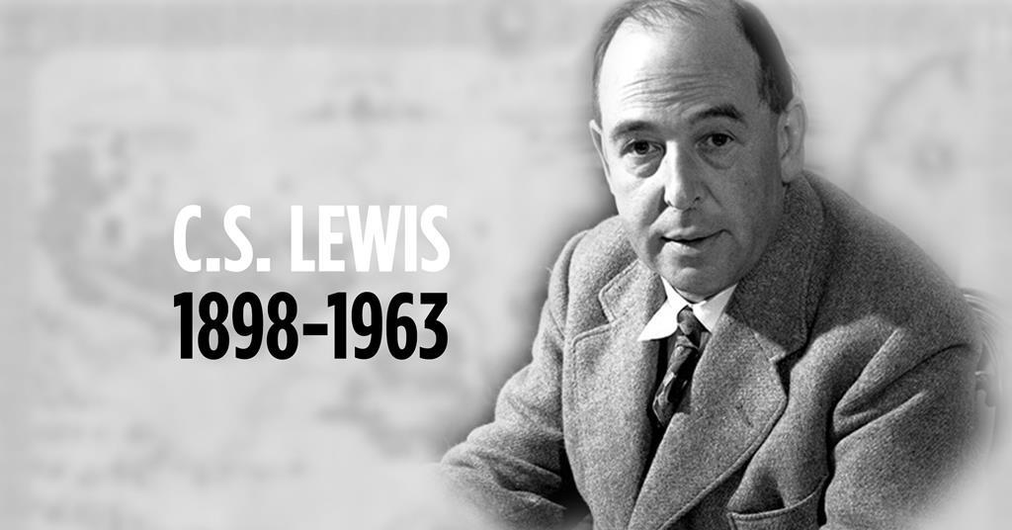
“If Christianity is False,
then it is of no importance.
If it is true,
then it is of infinite importance!
The only thing Christianity cannot be
Is moderately important!

Slide 29
Luke 9:18-20 “his disciples were with him: and he asked them, saying, Whom say the people that I am?
19 They answering said, John the Baptist; but some say, Elias; and others say, that one of the old prophets …
20 He said unto them, But whom say ye that I am?
Who do you “say” Jesus is?
Peter answering said, The Christ of God…
22 The Son of man must suffer many things, and be rejected of the elders and chief priests and scribes,
and be slain, and be raised the third day.”

Slide 30
Notice what Jesus asked them next.
Luke 9:23 “If any man will come after me, let him deny himself, and take up his cross daily, and follow me.
24 For whosoever will save his life shall lose it: but whosoever will lose his life for my sake, shall save it….
57 And it came to pass, that …a certain man said unto him, Lord, I will follow thee whithersoever thou goest.
58 And Jesus said unto him, Foxes have holes,
and birds of the air have nests;
but the Son of man hath not where to lay his head.

Slide 31
Luke 9:59 “And he said unto another, Follow me.
But he said, Lord, suffer me first
to go and bury my father.
60 Jesus said unto him, Let the dead bury their dead: but go thou and preach the kingdom of God.
61 And another also said, Lord, I will follow thee;
but let me first go bid them farewell…at my house,
62 And Jesus said unto him, No man, having put his hand to the plough, and looking back,
is fit for the kingdom of God.”

Slide 32
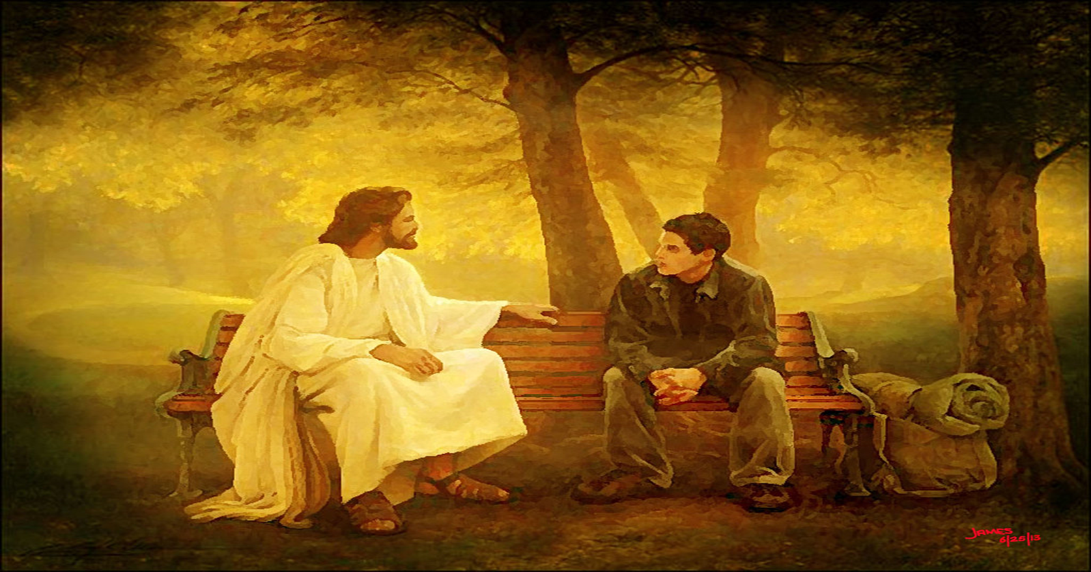
Luke 9:59
“Follow me. …
but Lord,
suffer me first…
61 another said, Lord, I will follow thee;
but let me first…”
John 10:27
Are you a “Me first” Christian?

