Slide 1
2 Cor 10:3-5; 1 Tim 4:1-2; 2 Tim. 2:1-4, 22-26

Slide 2
Eph. 6:11
“Put on the whole armor of God,
That ye may be able to stand against the wiles of the devil.”
(Methodei’a:
travesty, traps)
For we wrestle not against flesh and blood,
but against principalities, against powers,
against the rulers of the darkness of this world,
against spiritual wickedness in high places.”

Slide 3
2 Cor 2:11 “Lest Satan should get an advantage of us:
for we are not ignorant of his devices.”
(noe’ma: perception, purpose, disposition)
Satan, as “the god of this world” (2 Cor 4:4)
has an evil disposition (Jn 10:10);
and intentional designs/devices (Rev. 12-13)
for this world and all who are in it.
Ignorance of his disposition and devices,
as well as our own weakness and willfulness,
Leaves us vulnerable to distraction, deception, …

Slide 4
and ultimately defeat!
Mt 7:13 “Enter ye in at the strait (stenos) gate:
for wide is the gate, and broad is the way,
that leads to destruction, (apōlei’a: ruin, waste)
(Pr 14:12; 16:14; Mt 16:26; Phil. 3:18,19; Rev 9:11)
and many there be which go in thereat:…
15 “beware of false prophets…”
1 Cor. 10:5 “they were overthrown in the wilderness”
Katastrōn’nymi: thrown (cast) down.
(catastrophe)

Slide 5
Satan (the adversary) knows and uses:
Our Limited (self focused) Perspective to get us
to question God’s orders
and complain about ordeals.
Ex. 14; Num 11:1-3
Our Lustful Appetites for selfish satisfaction
to seduce us to sacrifice the permanent
on the altar of the immediate/temporary!
Num. 11:4-32
(His Word)
(His Ways)

Slide 6
Satan (the adversary) knows and uses:
Our Limited Perspective ➔ Complaining
Our Lustful Pleasures ➔ Compulsions
Our Propensity for Perversion to enable his
Distortion➔ Subversion ➔ Deception
Resulting in our Corruption!
Jer 3:20 “as a wife treacherously departeth from her husband, so have ye dealt treacherously with me, …
21 for they have perverted their way,
and they have forgotten the LORD their God.”

Slide 7
These work together to facilitate our Corruption, leading to our Rebellion
1 Cor 10:5-8 “they were overthrown in the wilderness.
6 Now these things were our examples, to the intent we should not lust after evil things, as they also lusted.
7 Neither be ye idolaters, as were some of them;
and ultimate destruction!
As it is written (in Ex. 32:6)
The people sat down to eat and drink,
and rose up to play.” (ṣāḥaq’: laugh, sport)

Slide 8
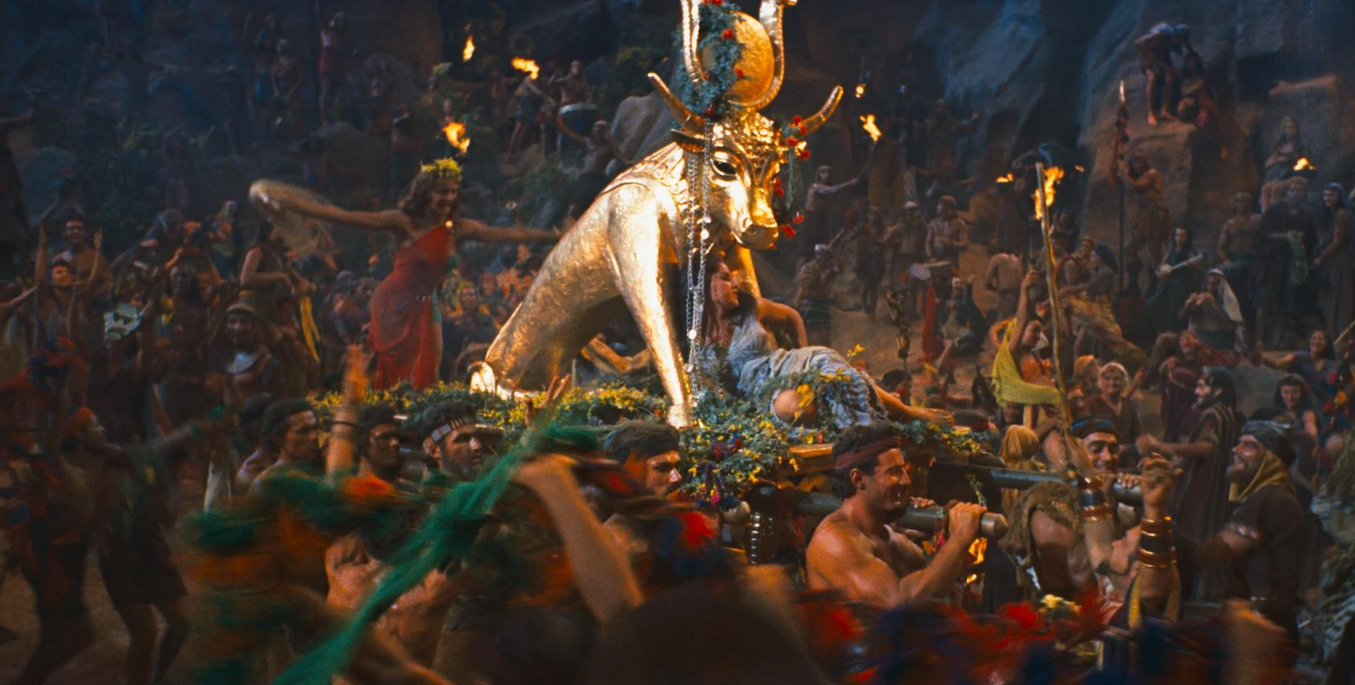
“Neither be ye idolaters, as were some of them”
Ex. 32:6 “The people sat down to eat and drink,
and rose up to play.” (ṣāḥaq’: laugh, sport)
Their perspective:
Just a little harmless fun!
God’s perspective vs 7 “The Lord said.. thy people, have corrupted themselves”
shāḥat’: wasted, ruined, destroyed
(Ex. 32)

Slide 9
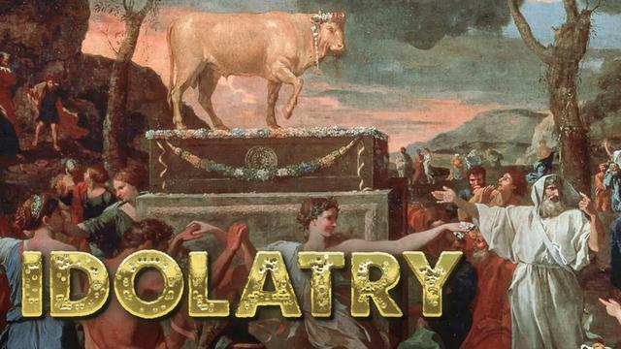
“Neither be ye idolaters”
1 Cor. 10:7
What exactly is Idolatry?
Why are we so prone to it?
How does it affect/corrupt us?
What can we do to resists it?

Slide 10
Idolatry defined
1. In English:
A. Websters defines it as:
1. The worship of idols. He defines an idol as:
“any thing which usurps the place of God in the hearts
of his rational creatures.” (Ro. 1:28)
2. Excessive attachment or veneration for any thing,
or that which borders on adoration.

Slide 11
2. In Hebrew (OT):
A. Lev 19:4 4 “Turn ye not unto idols,
(elîl: good for nothing! {from ‘al: nothing})
nor make to yourselves molten gods:
I am the LORD your God”
1) That’s why God calls idols “Vanities” in Dt. 32:21;
1 Kgs 16:13,26; Jer 8:19 “Why have they provoked me to anger with their graven images,
and strange vanities?” (heb’el: emptiness)

Slide 12
2) Solomon learned this the hard way.
Eccl. 2:14 “I have seen all the works that are done
under the sun; and, behold, all is vanity (hăbêl:
empty, unsatisfying;
and vexation (Reʿût’: feeding upon) of spirit.”
From raa: to shepherd!
a) Satan uses the world to try to shepherd us,
(aka: follow the crowd)
In order to lead us astray!
(Mk 4:19; 2 Cor 11:2,3; James 4:4; 1 Jn 2:15,16)
from habal: to lead astray!

Slide 13
2. Hebrew (OT):
B. Lev 26:30 “I will destroy your high places, and cut
down your images, and cast your carcasses upon
…your idols, (48x gillûl’îm: log, from galal: to roll/wallow)
and my soul shall abhor (gaal’: reject) you.”
1) This implies that the “idols” we “lean on” will:
a) Eventually turn on us! (aka: disappoint)
b) Cause God to turn away (His favor) from us.
Dt. 30:19 “I have set before you life and death,
blessing and cursing:
therefore choose life…”

Slide 14
2) Hebrew (OT):
C. 1 Sam 15:23 “rebellion is as the sin of witchcraft,
and stubbornness is as iniquity and idolatry.”
(terāpîm: image, idol) From rapha: to heal, repair
(Rapha comes from rapa: to slacken, weaken, consume)
1) This implies that the idol which we think will
“heal or repair”,
actually exposes us to witchcraft (demonic influence),
which ultimately weakens and consumes us!

Slide 15
3. What is Idolatry in the Greek (NT)
1 Cor 10:7 “Neither be ye idolaters” Eidōlolat’rēs: from eidolon (form) and latreu’o (to serve /worship)
by implication a heathen god!
19 “What say I then? that the idol is any thing, or that which is offered in sacrifice to idols is any thing?
20 …the things which the Gentiles sacrifice,
they sacrifice to devils, and not to God:
and I would not that ye should have
fellowship with devils.”

Slide 16
3. What is Idolatry in the Greek (NT)
1 Cor 10:7 “Neither be ye idolaters”
Anything that we serve/put above God
(Ex 20:3) “Thou shalt Have no other gods before me”
1) Becomes a type of “idol” (Ex. 20:4)
2) Puts us in fellowship/Partnership) with devils!
1 Cor 10:20 “…the things which the Gentiles sacrifice, they sacrifice to devils, and not to God:
and I would not that ye should have
fellowship with devils.”

Slide 17
Conclusion: What is idolatry? Hebrew (OT)
Lev 19:4 “Turn ye not unto idols…” (elîl: good for nothing)
Jer 8:19 “provoked me to anger with their graven images,
and strange vanities?” (heb’el: emptiness)
(from habal: to lead astray)
Lev. 26:30 “cast …upon your idols, (gillûl’îm: To wallow/trust)
and my soul shall abhor (gaal’: reject) you.”
1 Sam 15:23 “stubbornness is as iniquity and idolatry.”
(terāpîm: From rapha: promises to heal and repair)
(from rapa: actually weakens and consumes.)

Slide 18
Conclusion: What is idolatry?
Greek: (N.T.) 1 Cor. 10:19,20 “What say I then,
That the idol is any thing, or that which is offered in sacrifice to idols is any thing?
But…the things which the Gentiles sacrifice,
they sacrifice to devils, and not to God:
I would not that ye should have fellowship with devils.”
What’s really behind our sacrifice and service
to people and/or things,
may very well be devils!

Slide 19
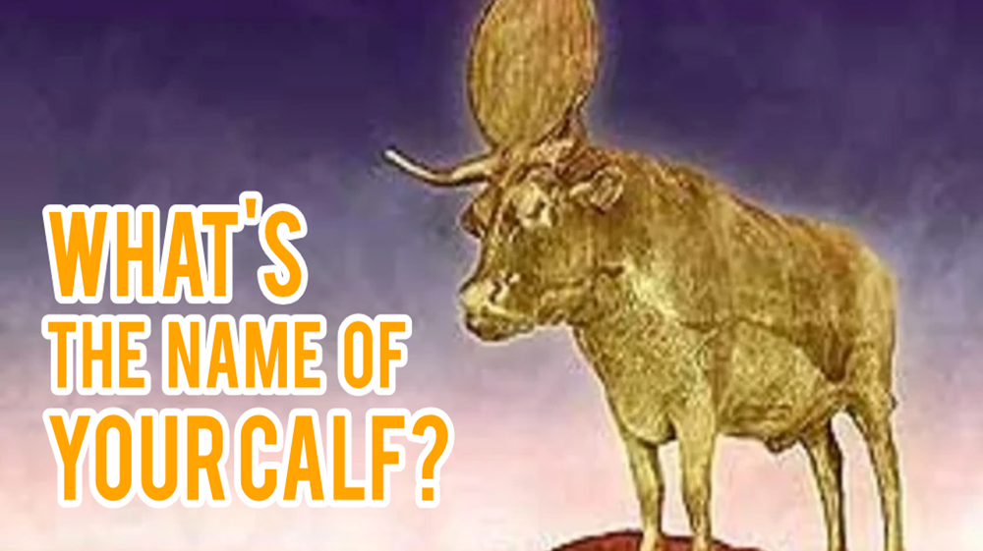
Conclusion: What is idolatry?
English: “any thing which usurps the place of God
in the hearts of his rational creatures.”

Slide 20
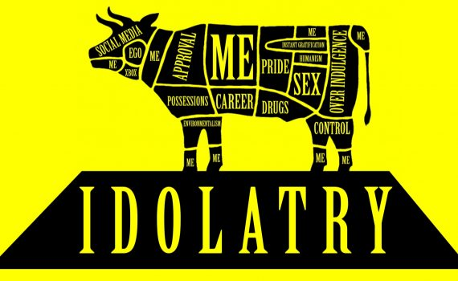
English: “any thing which usurps the place of God
in the hearts of his rational creatures.”

Slide 21
Col. 3:1 “If ye then be risen with Christ,
(then) seek those things which are above…
2 Set your affection (phroneō: focus, regard, value)
on things above, not on things on the earth. …
3 for ye are dead and your life is hid with Christ in God.
4 When Christ, who is our life, shall appear,
then shall ye also appear with him in glory.
5 Mortify therefore your members …upon the earth;
fornication, uncleanness, inordinate affection,
evil (kakos) concupiscence (epithumeo),

Slide 22
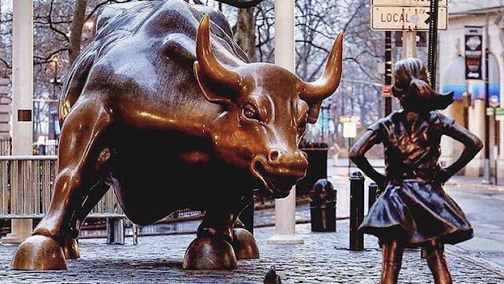
5 “and coveteousness,
which is idolatry!”
6 “For which things' sake the wrath of God cometh
on the children of disobedience:”

Slide 23
1 John opens with Fellowship with God.
Notice how it closes. 1 Jn 5:4 “this is the victory that overcometh the world, even our faith…
19 And we know that we are of God,
and the whole world lieth in wickedness.
20 And we know that the Son of God is come, and given us an understanding, that we may know him that is true,
and we are in him that is true…
21 Little children, keep (phylasso: guard) yourselves from idols. Amen.”

Slide 24
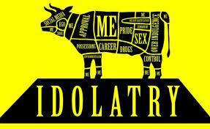
What will you begin to do to keep (protect)
yourself from the evil influence of Idols?

