Slide 1
ἀγαθός ἔργον
By Joseph Peters

Slide 2
Is salvation Based on good works?
Ephesians 2:8-9 (KJV)
⁸⁻⁹ For by grace are ye saved through faith; and that not of yourselves: it is the gift of God: Not of works, lest any man should boast.
Titus 3:5 (KJV)
⁵ Not by works of righteousness which we have done, but according to his mercy he saved us, by the washing of regeneration, and renewing of the Holy Ghost;
Romans 8:3 (KJV)
³ For what the law could not do, in that it was weak through the flesh, God sending his own Son in the likeness of sinful flesh, and for sin, condemned sin in the flesh:

Slide 3
Objective
So, why should Christians do good works?
For these three reasons

Slide 4
Rationale
1
For Ourselves
2
For Others
3
For God

Slide 5
for ourselves

Slide 6
for ourselves
Matthew 6:19-21 (KJV)
¹⁹ “Lay not up for yourselves treasures upon earth, where moth and rust doth corrupt, and where thieves break through and steal:
²⁰ But lay up for yourselves treasures in heaven, where neither moth nor rust doth corrupt, and where thieves do not break through nor steal:
²¹ For where your treasure is, there will your heart be also.”

Slide 7
How?
1 Corinthians 3:11-15 (KJV)
¹¹ For other foundation can no man lay than that is laid, which is Jesus Christ.
¹² Now if any man build upon this foundation gold, silver, precious stones, wood, hay, stubble;
¹³ Every man's work shall be made manifest: for the day shall declare it, because it shall be revealed by fire; and the fire shall try every man's work of what sort it is.
¹⁴ If any man's work abide which he hath built thereupon, he shall receive a reward.
¹⁵ If any man's work shall be burned, he shall suffer loss: but he himself shall be saved; yet so as by fire.

Slide 8

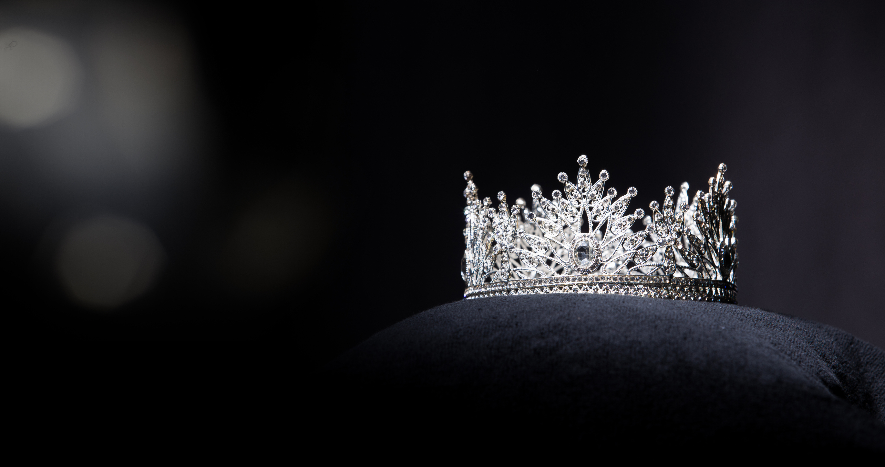
Examples
Gold, Silver, Precious Stones | Wood, Hay, Stubble
Tithe or give to charity | Buy a fancy new car
Spend time in a ministry | Spend time watching T.V.
Evangelize | Go to parties
Help someone | Help yourself

Slide 9
How?
Matthew 10:41-42 (KJV)
⁴¹ He that receiveth a prophet in the name of a prophet shall receive a prophet's reward; and he that receiveth a righteous man in the name of a righteous man shall receive a righteous man's reward.
⁴² And whosoever shall give to drink unto one of these little ones a cup of cold water only in the name of a disciple, verily I say unto you, he shall in no wise lose his reward.
Mark 9:41 (KJV)
⁴¹ For whosoever shall give you a cup of water to drink in my name, because ye belong to Christ, verily I say unto you, he shall not lose his reward.

Slide 10
How?
Matthew 6:1-4 (KJV)
¹ Take heed that ye do not your alms before men, to be seen of them: otherwise ye have no reward of your Father which is in heaven.
² Therefore when thou doest thine alms, do not sound a trumpet before thee, as the hypocrites do in the synagogues and in the streets, that they may have glory of men. Verily I say unto you, They have their reward.
³ But when thou doest alms, let not thy left hand know what thy right hand doeth:
⁴ That thine alms may be in secret: and thy Father which seeth in secret himself shall reward thee openly.

Slide 11
for Others

Slide 12
How?
Does loving others help them?
Matthew 22:39b (KJV)
“Thou shalt love thy neighbour as thyself.”
Matthew 5:44 (KJV)
“But I say unto you, Love your enemies, bless them that curse you, do good to them that hate you, and pray for them which despitefully use you, and persecute you;”

Slide 13
How?
Treating others the way that we want to be treated
Matthew 7:12 (KJV)
“Therefore all things whatsoever ye would that men should do to you, do ye even so to them: for this is the law and the prophets. “

Slide 14
How?
Being kind and forgiving towards others
Ephesians 4:32 (KJV)
“And be ye kind one to another, tenderhearted, forgiving one another, even as God for Christ's sake hath forgiven you.”

Slide 15
How
By being a good witness
Acts 1:8 (KJV)
“But ye shall receive power, after that the Holy Ghost is come upon you: and ye shall be witnesses unto me both in Jerusalem, and in all Judaea, and in Samaria, and unto the uttermost part of the earth”

Slide 16
Know Them by their Fruit
You know a tree based on it’s fruit
Matthew 7:15-20 (KJV)
¹⁵ Beware of false prophets, which come to you in sheep's clothing, but inwardly they are ravening wolves.
¹⁶ Ye shall know them by their fruits. Do men gather grapes of thorns, or figs of thistles?
¹⁷ Even so every good tree bringeth forth good fruit; but a corrupt tree bringeth forth evil fruit.
¹⁸ A good tree cannot bring forth evil fruit, neither can a corrupt tree bring forth good fruit.
¹⁹ Every tree that bringeth not forth good fruit is hewn down, and cast into the fire.
²⁰ Wherefore by their fruits ye shall know them.

Slide 17
Source of the Fruit
You know a tree based on it’s fruit
John 15:4-5 (KJV)
⁴ Abide in me, and I in you. As the branch cannot bear fruit of itself, except it abide in the vine; no more can ye, except ye abide in me.
⁵ I am the vine, ye are the branches: He that abideth in me, and I in him, the same bringeth forth much fruit: for without me ye can do nothing.

Slide 18
Being a bad witness
You know a tree based on it’s fruit
Galatians 5:19-20 (KJV)
19 “Now the works of the flesh are manifest, which are these; Adultery, fornication, uncleanness, lasciviousness,
20 Idolatry, witchcraft, hatred, variance, emulations, wrath, strife, seditions, heresies…”

Slide 19
Being a Good witness
You know a tree based on it’s fruit
Galatians 5:22-23 (KJV)
22 “But the fruit of the Spirit is love, joy, peace, longsuffering, gentleness, goodness, faith,
23 Meekness, temperance: against such there is no law.”

Slide 20
for God

Slide 21
How?
Ephesians 2:10 (KJV)
¹⁰ For we are his workmanship, created in Christ Jesus unto good works, which God hath before ordained that we should walk in them.
Titus 2:14 (KJV)
¹⁴ Who gave himself for us, that he might redeem us from all iniquity, and purify unto himself a peculiar people, zealous of good works.

Slide 22
Clarification
Ephesians 2:8-9 (KJV)
⁸⁻⁹ For by grace are ye saved through faith; and that not of yourselves: it is the gift of God: Not of works, lest any man should boast.
Titus 3:5 (KJV)
⁵ Not by works of righteousness which we have done, but according to his mercy he saved us, by the washing of regeneration, and renewing of the Holy Ghost;

Slide 23
Why do good
John 14:15 (KJV)
¹⁵ If ye love me, keep my commandments.
We love Him
We appreciate Him
We are His children

Slide 24
Conclusion
Why Should We Do good?
1
For Ourselves
2
For others
3
For God

