Slide 1
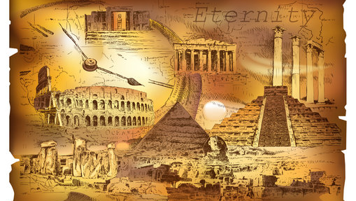
The Drama of the Ages

Slide 2
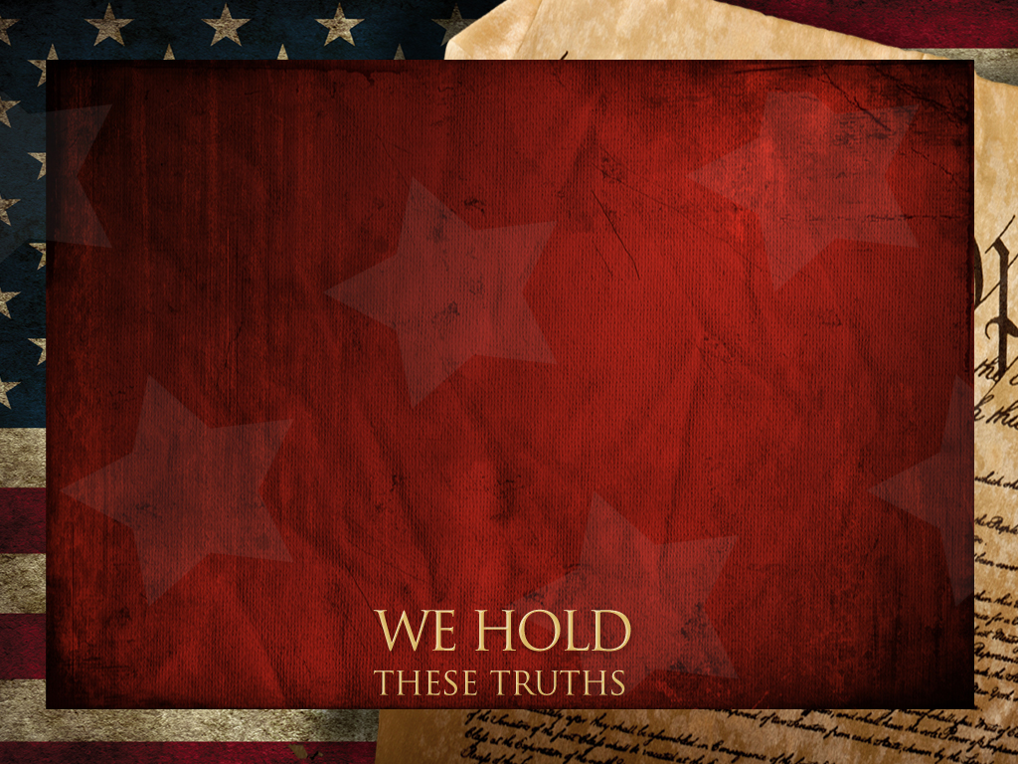
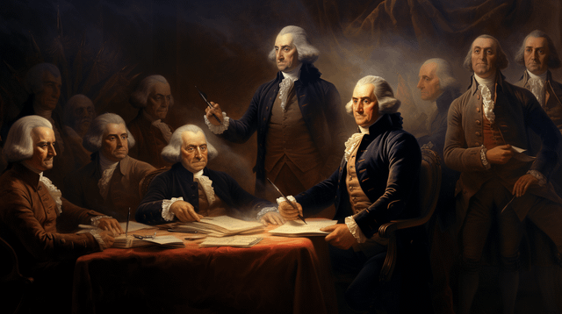
“We hold these truths to be self-evident,
That all men are created equal,
and endowed by their creator…”

Slide 3
“And for the support of this Declaration,
with a firm reliance on the protection
of divine Providence,
we mutually pledge to each other
our Lives, our Fortunes and our sacred Honor.”

Slide 4
Much has changed since the Birth of America’s independence from England,
And acknowledged Dependence on God,
But some things haven’t!
While our concept of “truth” may have changed,
Actual Truth is Changeless!

Slide 5
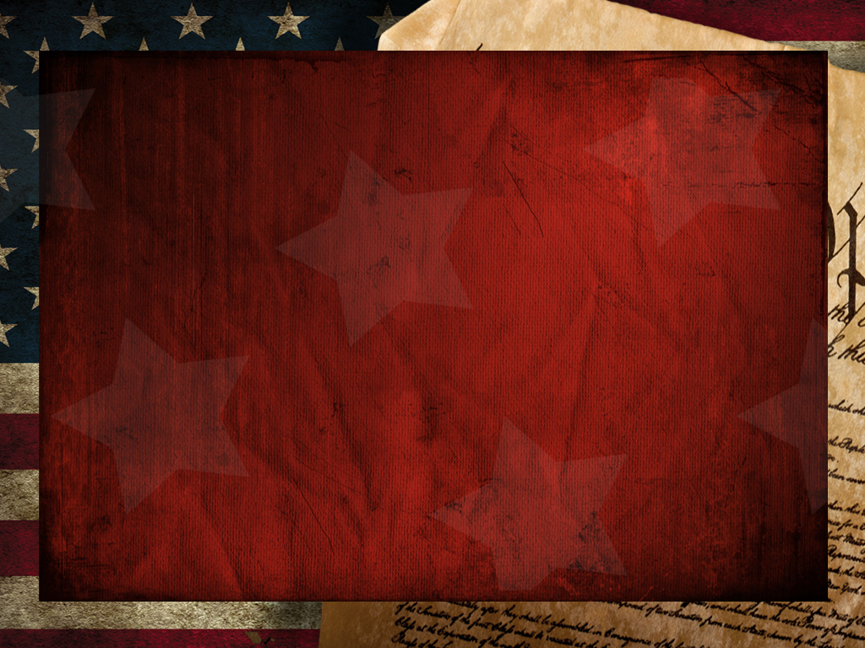
Heb. 1:10-14 “Thou, Lord, in the beginning hast laid the foundation of the earth;
and the heavens are the works of thine hands:
They shall perish; but thou remainest;
and they all shall wax old…
but thou art the same…”
God’s unchanging nature in a changing world
was the theme of our recent VBS.

Slide 6
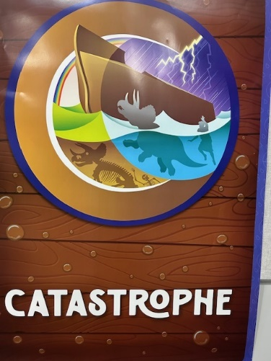
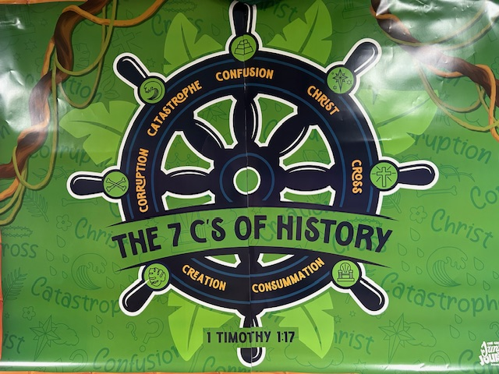
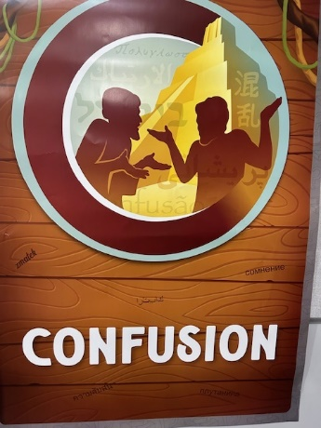
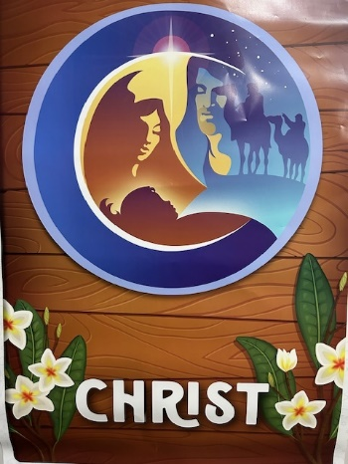

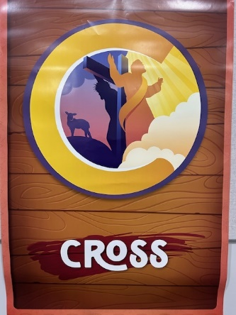

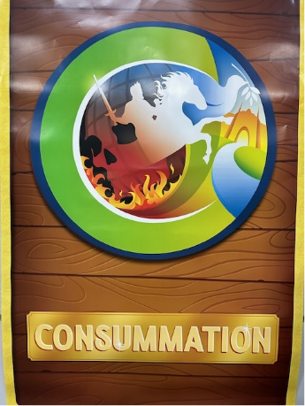

Slide 7
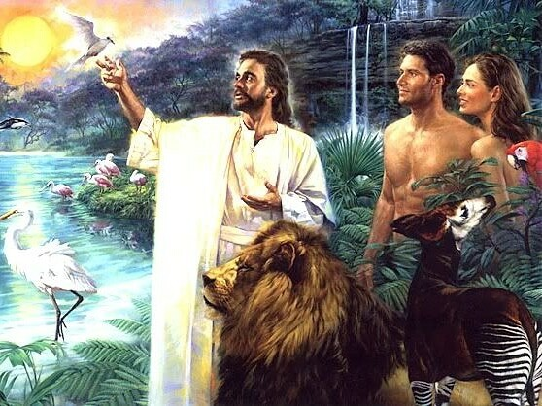
1. Creation Gen. 1:31
“God saw every thing that he had made,
and behold,
it was
very good.”
ṭôḇ mᵊ’ōḏ
Exceedingly Precious
Donald McCrady

Slide 8
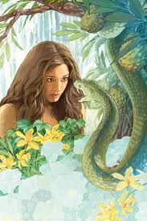
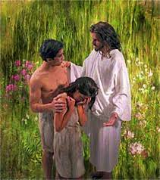
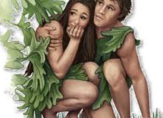
Because of Satan’s seductive lies
and Adam’s selfish sin,
Creation turned into Corruption!

Slide 9
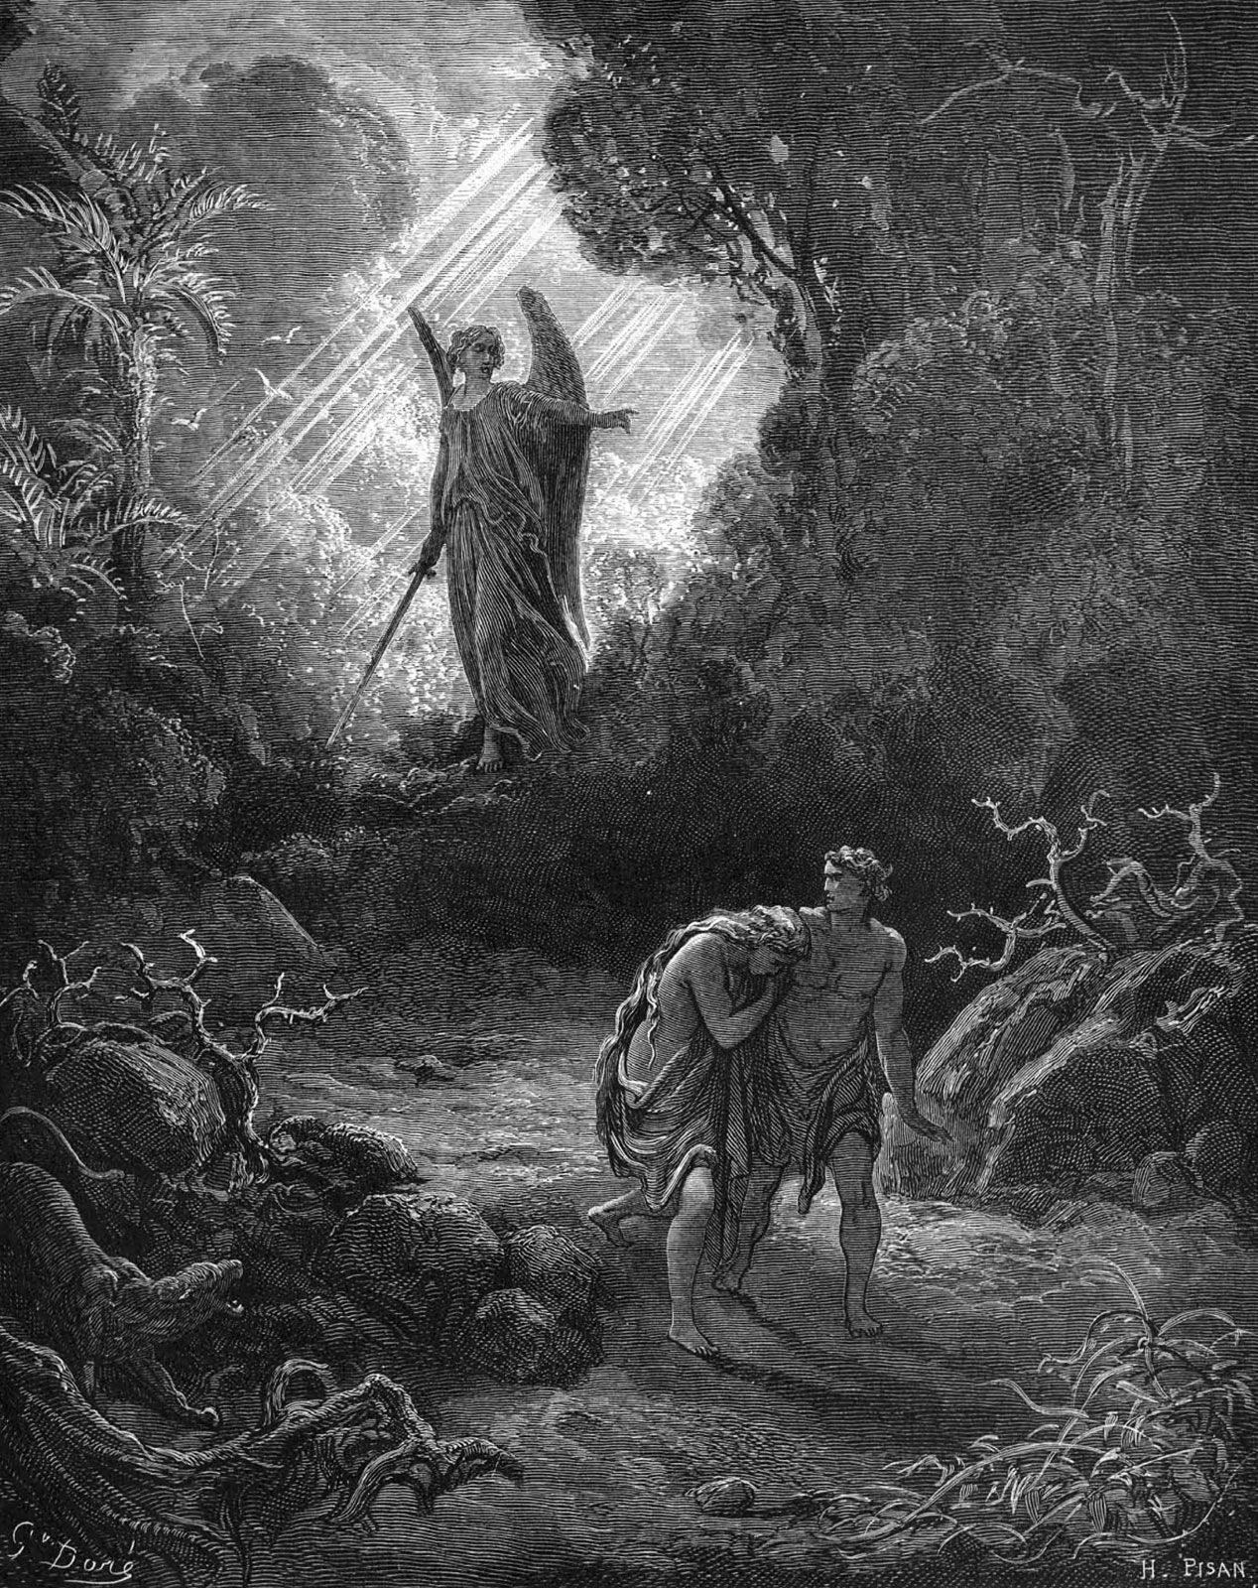
2. Corruption Gen. 3:17
“Cursed be the ground for thy sake…”
Genesis 6:5 “GOD saw that the wickedness of man
was great in the earth,
and that every imagination of the thoughts of his heart was only evil continually.”

Slide 10
Corruption eventually results in:
3. Catastrophe Gen. 6:12
“The earth also was corrupt before God,
(šāḥaṯ’: destroyed, spoiled, decayed)
Consequences: and … filled with violence.”
(ḥāmās’: violence, cruelty, injustice)
Correction: vs 17 “I will bring a flood”
8 “But Noah found grace…”

Slide 11
Corruption ➔ Catastrophe ➔
4. Confusion Gen 11 Due to continued
corruption & rebellion God decided to
“confound (balal’: mix, confuse) their language…
Therefore is the name of it called Babel;” (confusion) Gen. 11:7
This is the name of Earth’s final capital!
(Rev. 17-18)

Slide 12
5. Christ (Is. 53; Jn 3:16; Gal. 4:4
1 Thes. 1:15 “This is a faithful saying, and worthy of all acceptation, that Christ (christos: anointed) Jesus (iēsous : Jehovah is salvation)
came into the world to save sinners…”
Lk 19:10 “For the Son of man is come
to seek and to save that which was lost.”

Slide 13
He did this through the C: Cross
Jn 3:14-17; Ro. 5:8; 6:23; 1 Cor 1:18
“For the preaching of the cross is to them that perish foolishness;
but unto us which are saved
it is the power of God.”

Slide 14
6) C: Cross Eph. 2:14-16 “he is our peace …
Having abolished in his flesh the enmity,
even the law of commandments …;
for to make in himself of twain one new man,
so making peace;
And that he might reconcile both unto God in one body by the cross,
having slain the enmity thereby:”

Slide 15
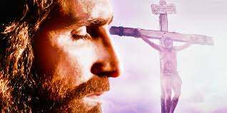
6) C: Cross Col. 2:13
“And you, being dead in your sins hath he quickened together with him,
having forgiven
you all trespasses”

Slide 16
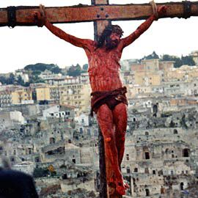
6) C: Cross Col. 2:13,14
“Blotting out the handwriting of ordinances that was against us…
took it out of the way
nailing it to his cross!”
2 Cor. 5:21

Slide 17
Because of the Cross, we have the hope of the:
7) C: Consummation: (Completion) Rev. 21:1-4
“I saw a new heaven and a new earth:
for the first heaven and the first earth were passed away; and there was no more sea.
I John saw the holy city, new Jerusalem, coming down from God out of heaven,
prepared as a bride adorned for her husband.

Slide 18
And I heard a great voice out of heaven saying,
Behold, the tabernacle of God is with men, and he will dwell with them, and they shall be his people, and God himself shall
be with them, and be their God.
God shall wipe away all tears from their eyes;
and there shall be no more death,
neither sorrow, nor crying,
neither shall there be any more pain:
for the former things are passed away.”

Slide 19
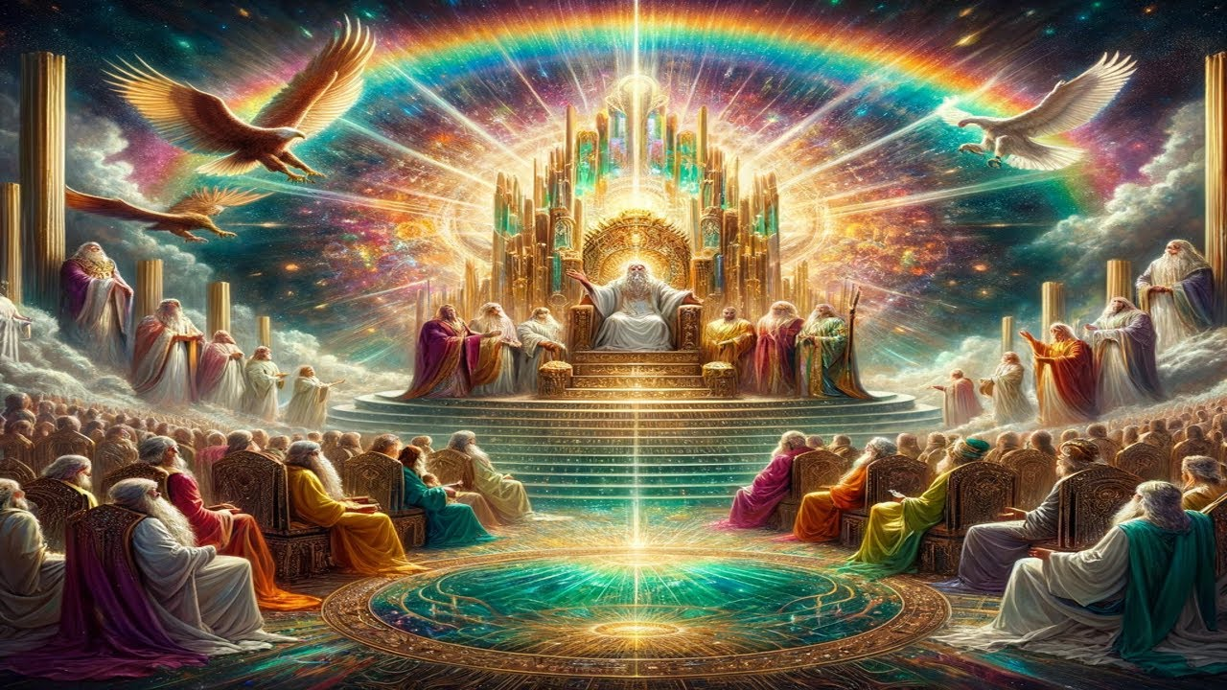
5 And he that sat upon the throne said,
Behold, I make all things new.
Write: for these words are true and faithful.”

Slide 20
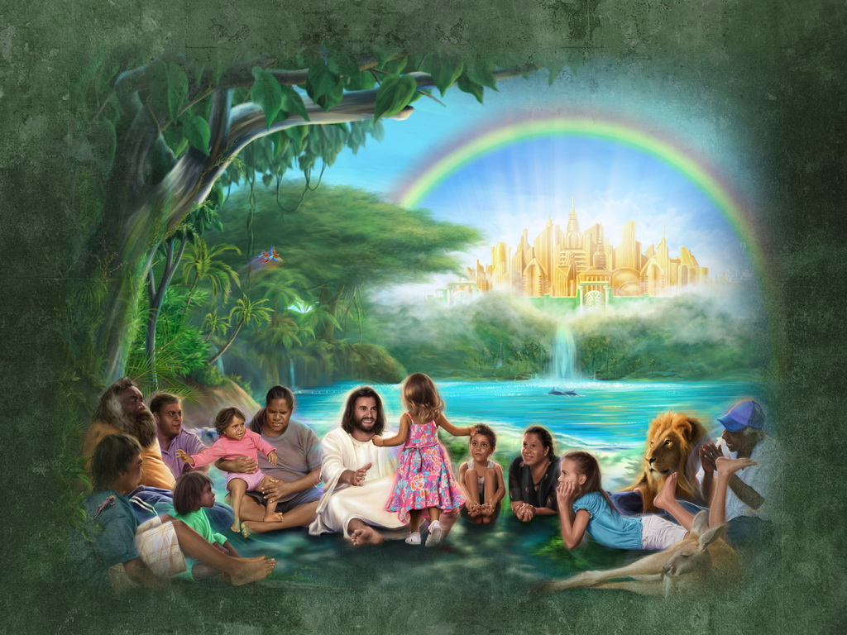
Consummation
Eden Restored Rev 22

Slide 21
This is the cycle of history
It begins with Creation
(God’s original design/desire)
It’s corrupted by Sin (Satan’s desire
➔ Catastrophe (suffering)
➔ Confusion (stupid)
2 Cor. 4:4; 2 Tim. 2:24-26
(and your story!)

Slide 22
is your story!
This cycle of history
Creation ➔ Corruption ➔ Catastrophe Confusion Ro. 1:28
“even as they did not like to retain God in their knowledge,
God gave them over to a reprobate mind”

Slide 23
Thankfully God stepped in with:
Christ ➔ Cross (2 Cor. 4:6)
1 Pt 1:18-20 “Forasmuch as ye know that ye were not redeemed with corruptible things, …
But with the precious blood of Christ, as of a lamb without blemish and without spot:
Who verily was foreordained
before the foundation of the world,
but was manifest in these last times
for you!”

Slide 24
Because of Christ and the Cross
God’s desire/design can be restored.
(Ps. 23:1-3; Is. 61:1-3; 2 Cor 5:17)
Satan doesn’t “give up” when we’re saved,
But seeks to repeat this cycle
in the hope of us getting “stuck” in guilt, shame, and/or pride. (1 Jn 1:6-10)

Slide 25
Because of Christ and the Cross
God’s desire/design can be restored.
Ps. 23:1 “The Lord is my shepherd…
3 “He restoreth my soul!
He leadeth me in the paths of righteousness for His name’s sake.”

Slide 26
Where are you in this cycle?
2 Cor 4:4
2 Cor 4:6

Slide 27
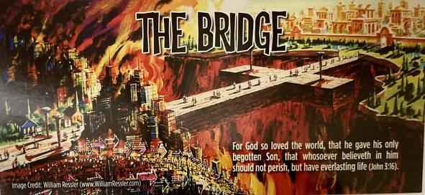
Christ and the Cross (2 Cor 4:6) are
(John 3:16; 14:6)
To God’s final Consummation (2 Cor. 5)

Slide 28
Have you trusted Christ as your savior?
Are you following Him as your
“Good Shepherd” Jn 10:11
Or “the thief” (John 10:10a)
How can you (and others) tell?
John 10:26-29

Slide 29
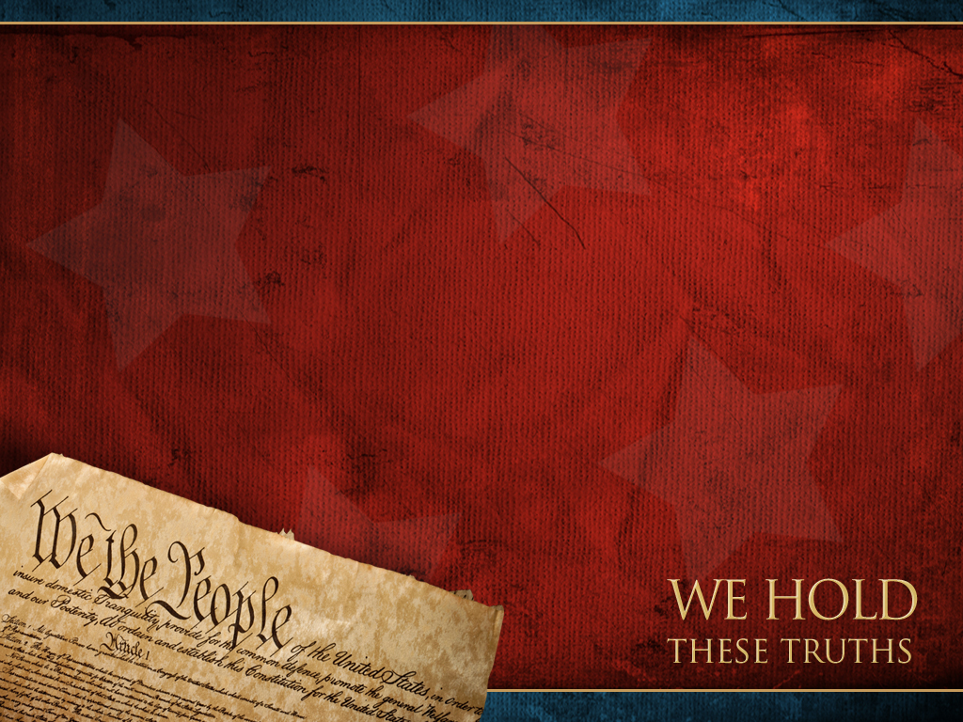
What “self evident” truths are you Holding?
Jn 3:16-18; Jn 14:6
Are you willing to pledge your
“Lives…Fortunes and sacred Honor”
On anything less?
(Trusting)

